Slide 1






Homework #9 Feedback
Problem 5.35 trends
Problem 5.41 trends
a.
b.
c.
$$\begin{matrix}max & cx \\ s.t. & Ax≤b \\ & x≥0\end{matrix}$$
$$\begin{matrix}max & cx \\ s.t. & Ax≥b \\ & x≥0\end{matrix}$$
$$\begin{matrix}min & cx \\ s.t. & Ax≤b \\ & x≥0\end{matrix}$$
d.
e.
other.
$$\begin{matrix}min & cx \\ s.t. & A_{1}x=b_{1} \\ & A_{2}x≥b_{2} \\ & x≥0\end{matrix}$$
$$\begin{matrix}min & cx \\ s.t. & Ax=b \\ & x≤u \\ & x≥l\end{matrix}$$
$$\begin{matrix}min & c_{1}x_{1}+c_{2}x_{2} \\ s.t. & A_{1}x_{1}=b_{1} \\ & A_{2}x_{2}≥b_{2} \\ & x_{1}≥l \\ & x_{2}≥0\end{matrix}$$

Slide 2


Slide 3
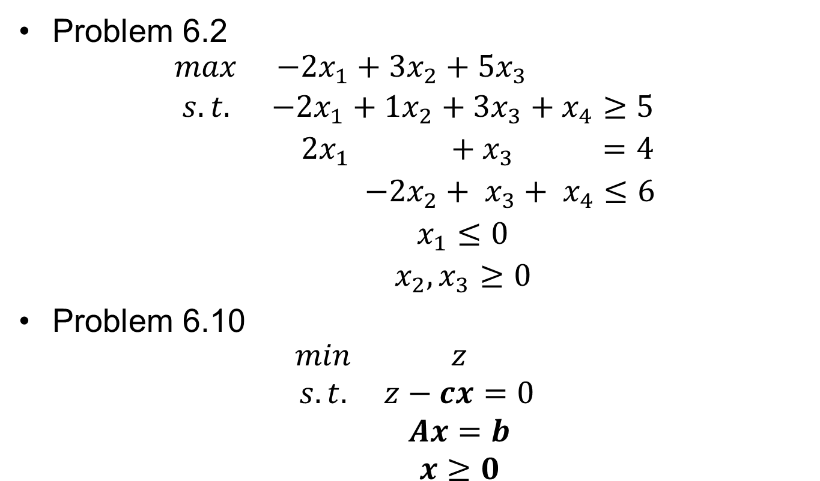
Homework #10 Discussion
Problem 6.2
$$\begin{matrix}max & −2x_{1}+3x_{2}+5x_{3} \\ s.t. & −2x_{1}+1x_{2}+3x_{3}+x_{4}≥5 \\ & 2x_{1} +x_{3} =4 \\ & −2x_{2}+ x_{3}+ x_{4}≤6 \\ & x_{1}≤0 \\ & x_{2},x_{3}≥0\end{matrix}$$
Problem 6.10
$$\begin{matrix}min & z \\ s.t. & z−cx=0 \\ & Ax=b \\ & x≥0\end{matrix}$$

Slide 4
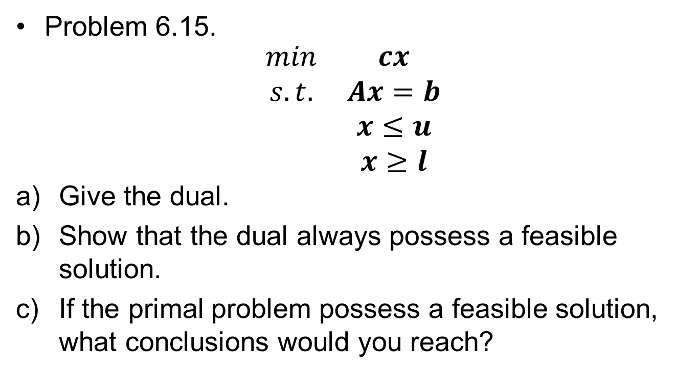
Another Duality Question
Problem 6.15.
$$\begin{matrix}min & cx \\ s.t. & Ax=b \\ & x≤u \\ & x≥l\end{matrix}$$
Give the dual.
Show that the dual always possess a feasible solution.
If the primal problem possess a feasible solution, what conclusions would you reach?

Slide 5
OPER 610 Lesson 11 Sensitivity Analysis
Dr Brian J. Lunday
Office: Rm 201E, Bldg 641

Slide 6

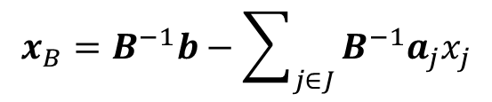
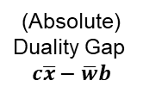



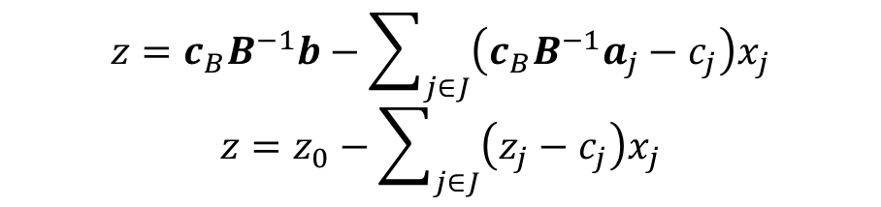
Change in the cost vector $c$
Could it affect feasibility?
If so, how? If not, why not?
How would you know?
Could it affect optimality?
If so, how?
How would you know?
$$x_{B}=B^{−1}b−\sum_{j∈J}{B^{−1}a_{j}x_{j}}$$
$$z=c_{B}B^{−1}b−\sum_{j∈J}{\left({c_{B}B}^{−1}a_{j}−c_{j}\right)x_{j}}$$
$$z=z_{0}−\sum_{j∈J}{\left(z_{j}−c_{j}\right)x_{j}}$$
$$c\overline{x}≥cx^{∗}$$
(Absolute)
Duality Gap
$$c\overline{x}−\overline{w}b$$
$$z^{∗}=cx^{∗}=w^{∗}b$$
$$\overline{w}b≤w^{∗}b$$

Slide 7

Change in the right-hand-side $b$
Could it affect feasibility?
If so, how? If not, why not?
How would you know?
Could it affect optimality?
If so, how?
How would you know?
$$x_{B}=B^{−1}b−\sum_{j∈J}{B^{−1}a_{j}x_{j}}$$
$$z=c_{B}B^{−1}b−\sum_{j∈J}{\left({c_{B}B}^{−1}a_{j}−c_{j}\right)x_{j}}$$
$$z=z_{0}−\sum_{j∈J}{\left(z_{j}−c_{j}\right)x_{j}}$$
$$c\overline{x}≥cx^{∗}$$
(Absolute)
Duality Gap
$$c\overline{x}−\overline{w}b$$
$$z^{∗}=cx^{∗}=w^{∗}b$$
$$\overline{w}b≤w^{∗}b$$

Slide 8

Change in the constraint matrix $A$
Could it affect feasibility?
If so, how? If not, why not?
How would you know?
Could it affect optimality?
If so, how?
How would you know?
Do your answers depend
on which column is changed?
$$x_{B}=B^{−1}b−\sum_{j∈J}{B^{−1}a_{j}x_{j}}$$
$$z=c_{B}B^{−1}b−\sum_{j∈J}{\left({c_{B}B}^{−1}a_{j}−c_{j}\right)x_{j}}$$
$$z=z_{0}−\sum_{j∈J}{\left(z_{j}−c_{j}\right)x_{j}}$$

Slide 9
Add a new activity
Could it affect feasibility?
If so, how? If not, why not?
How would you know?
Could it affect optimality?
If so, how?
How would you know?
$$x_{B}=B^{−1}b−\sum_{j∈J}{B^{−1}a_{j}x_{j}}$$
$$z=c_{B}B^{−1}b−\sum_{j∈J}{\left({c_{B}B}^{−1}a_{j}−c_{j}\right)x_{j}}$$
$$z=z_{0}−\sum_{j∈J}{\left(z_{j}−c_{j}\right)x_{j}}$$

Slide 10
Add a new constraint
Could it affect feasibility?
If so, how? If not, why not?
How would you know?
Could it affect optimality?
If so, how?
How would you know?
$$x_{B}=B^{−1}b−\sum_{j∈J}{B^{−1}a_{j}x_{j}}$$
$$z=c_{B}B^{−1}b−\sum_{j∈J}{\left({c_{B}B}^{−1}a_{j}−c_{j}\right)x_{j}}$$
$$z=z_{0}−\sum_{j∈J}{\left(z_{j}−c_{j}\right)x_{j}}$$

Slide 11
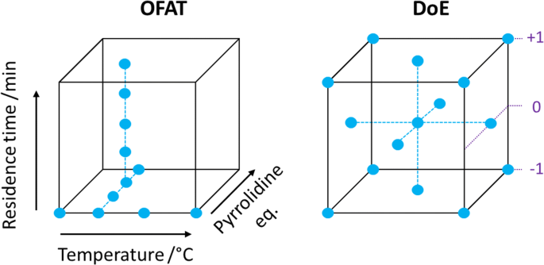
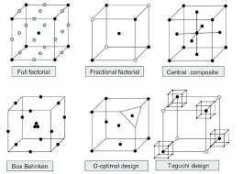
OFAT vs. Designed Experiment

Slide 12
Questions & Discussion

